Slide 1
Chapter 8: Receivables
Financial & Managerial Accounting, 16e

Slide 2
Accounts Receivable
The most common transaction creating a receivable is selling merchandise or services on account (on credit).
The receivable is recorded as a debit to Accounts Receivable.
Such accounts receivable are normally collected within a short period, such as 30 or 60 days.
They are classified on the balance sheet as a current asset.

Slide 3
Notes Receivable
Notes receivable are amounts that customers owe for which a formal, written instrument of credit has been issued.
If notes receivable are expected to be collected within a year, they are classified on the balance sheet as a current asset.
Notes are often used for credit periods of more than 60 days.
Notes may also be used to settle a customer’s account receivable.
Notes and accounts receivable that result from sales transactions are sometimes called trade receivables.

Slide 4
Uncollectible Receivables
Regardless of how careful a company is in granting credit, some credit sales will be uncollectible.
The two methods of accounting for uncollectible receivables are as follows:
The direct write-off method records bad debt expense only when an account is determined to be worthless.
The direct write-off method is often used by small companies and companies with few receivables.
The allowance method records bad debt expense by estimating uncollectible accounts at the end of the accounting period.
Generally accepted accounting principles (GAAP) require companies with a large amount of receivables to use the allowance method.
The Allowance for Doubtful Accounts is a contra asset account and has normal credit balance

Slide 5
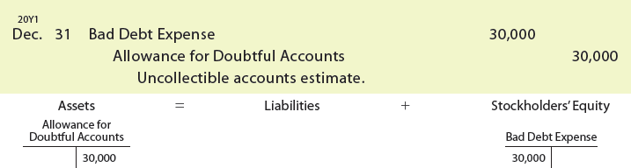
Allowance Method for Uncollectible Accounts
Using the $30,000 estimate, the following adjusting entry is made on December 31, 20Y1:

Slide 6
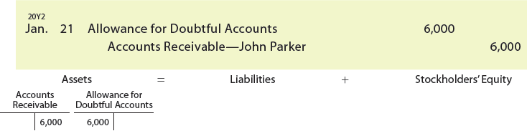
Write-Offs to the Allowance Account
When a customer’s account is identified as uncollectible, it is written off against the allowance account.
This requires the company to remove the specific accounts receivable and an equal amount from the allowance account.
On January 21, 20Y2, John Parker’s account of $6,000 with ExTone Company is written off as follows:

Slide 7
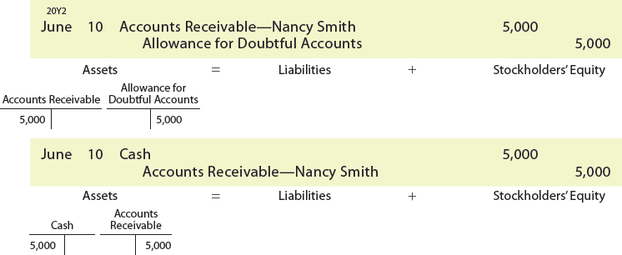
Write-Offs to the Allowance Account
Assume that Nancy Smith’s account of $5,000, which was written off on April 2, 20Y2, is collected later, on June 10. ExTone Company journalizes the reinstatement and the collection as follows:

Slide 8
Estimating Uncollectibles
The allowance method requires an estimate of uncollectible accounts at the end of the period.
This estimate of current expected credit losses is normally based on past experience, industry averages, current economic conditions, and forecasts of the future.
The two methods used to estimate uncollectible accounts are as follows:
Percent of sales method.
Analysis of receivables method.

Slide 9
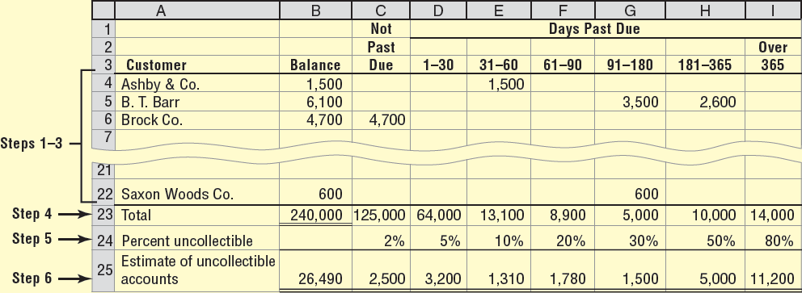
Aging of Receivables Schedule, December 31, 20Y2
The analysis of receivables method is based on the assumption that the longer an account receivable is outstanding, the less likely it will be collected.

Slide 10
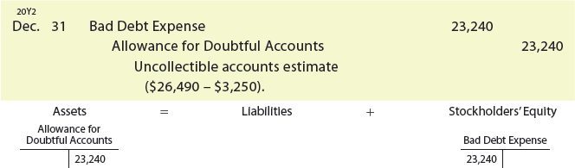
Analysis of Receivables Method
For ExTone, the unadjusted balance of the allowance account is a credit balance of $3,250.
The amount to be added to this balance is therefore $23,240 ($26,490 – $3,250). The adjusting entry is as follows:

Slide 11
Notes Receivables
Notes receivable are amounts that customers owe for which a formal, written instrument of credit has been issued.
Notes are often used for credit periods of more than 60 days.
The amount for which a promissory note is written is called the face value
The amount of the promissory note plus the interest earned on the due date is called the maturity value

Slide 12
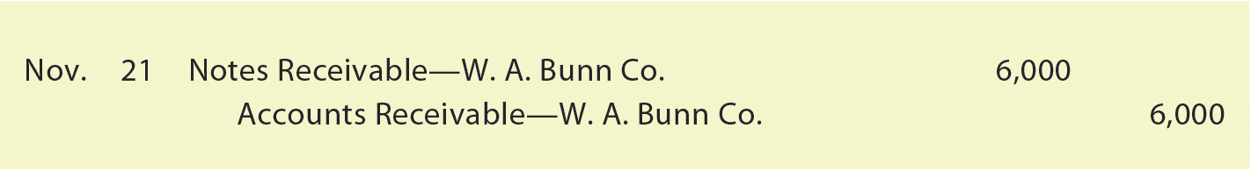
Accounting for Notes Receivable
Assume that a company accepts a 30-day, 12% note dated November 21 in settlement of the account of W. A. Bunn Co., which is past due and has a balance of $6,000. The company journalizes the receipt of the note as follows:

Slide 13
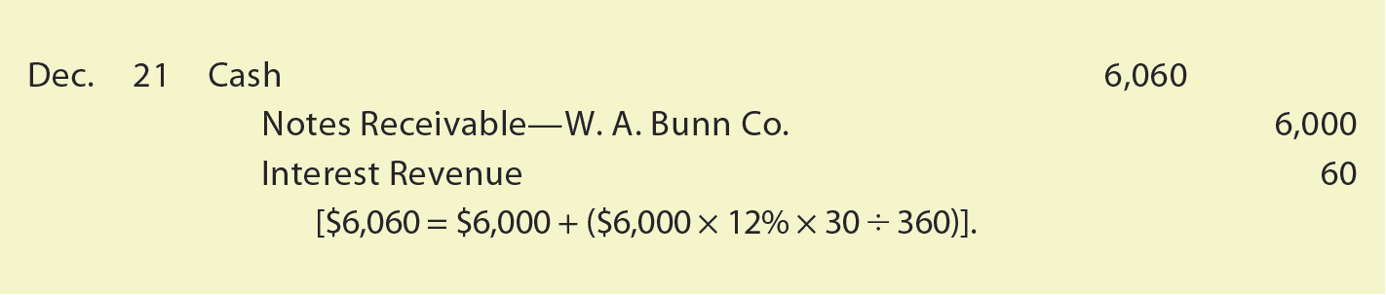
Accounting for Notes Receivable
At the due date, the company journalizes the receipt of $6,060 ($6,000 face amount plus $60 interest) as follows:

Slide 14
Knowledge Check Activity 3
Anderson Paper Mills, Inc. signs a 120-day, $8,000 note with their local bank at 9% annual interest. Assuming a 360-day year, how much interest will they pay on this note?
$240
$720
$360
$180

Slide 15
Knowledge Check Activity 3: Answer
Anderson Paper Mills, Inc. signs a 120-day, $8,000 note with their local bank at 9% annual interest. Assuming a 360-day year, how much interest will they pay on this note?
Answer: a. $240
The formula is:

